Slide 1
Study of Multi-Objective Optimization using Evolutionary Algorithms
Shivam Pandey (160010003) Supervisor :
School of Mathematics & Computer Science Prof. Somenath Biswas
Indian Institute of Technology Goa

Slide 2
Motivation
Evolutionary algorithms (EAs)
Well-suited for optimization problems involving several, often conflicting objectives.
EAs are capable of searching for multiple optimal solutions concurrently in a single simulation run, which makes EAs unique for solving multi-objective optimization problems (MOOPs).

Slide 3
Problem Statement
Studying and exploring existing multi-objective evolutionary algorithms (MOEAs) like Non-dominated Sorting Genetic Algorithm-II (NSGA-II), Pareto-Archived Evolution Strategy (PAES), etc.
Formulate possible improvement ideas to propose a better algorithm, in terms of “quality of solutions”, “running time", or preferably both.

Slide 4
Literature Review (Dominance)
In the initial phase of my work, the formulation of a MOOP was studied. Most multi-objective optimization algorithms use the concept of dominance and pareto-optimality in their search.
A solution “x” is said to dominate the other solution “y”, if both the following conditions are true :
• The solution x is no worse than y in all objectives.
• The solution x is strictly better than y in at least one objective.
1

Slide 5
Literature Review (Pareto-Optimality)
Among a set of solutions P, the non-dominated set of solutions P’ are those that are not dominated by any member of the set P.
The non-dominated set of the entire feasible search space is defined as the Pareto-Optimal set.
The curve formed in the objective space by joining these pareto-optimal set of solutions is known as the pareto front.
2

Slide 6
Literature Review (NSGA-2)
Studied an existing elitist EA, namely Non-dominated Sorting Genetic Algorithm-2 (NSGA-2).
Implemented the NSGA-2 in Python3 on a MOOP.
Initially, I ran NSGA-2 on a two-objective optimization problem:
Minimize x² and (x-2)² ; -10³≤x≤10³
3

Slide 7
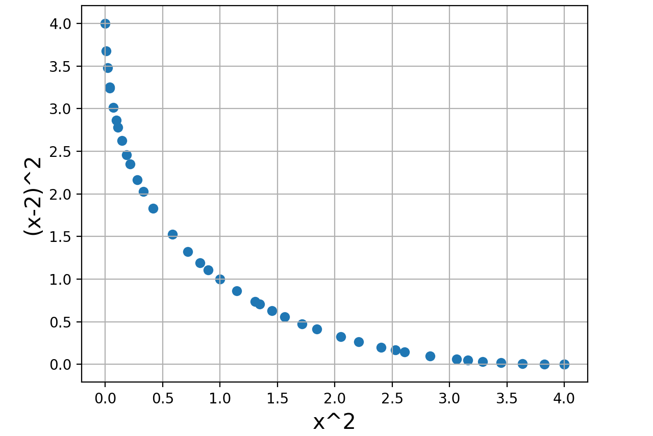
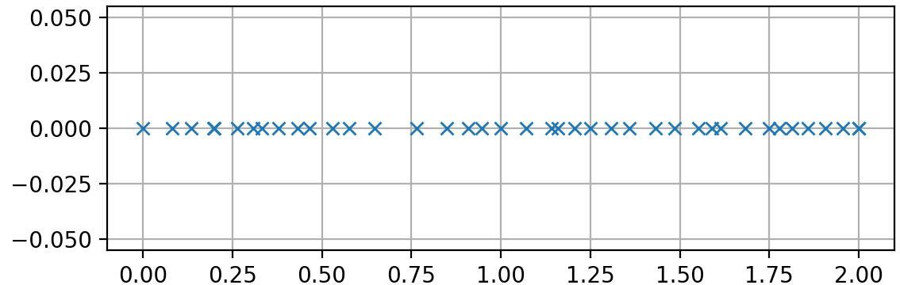
Successful NSGA-2
Implementation
Population size = 40 , evolved for 150 generations
Tested on the following Two-Objective Problem :-
Minimize x²
Minimize (x-2)²
subject to -10³ ≤ x ≤ 10³
Result : Obtained a diverse pareto-front

Slide 8
Two Goals of Multi-Objective Optimization
To find a set of solutions as close as possible to the pareto-optimal front.
To find a set of solutions as diverse as possible (uniformly spread out solution set).

Slide 9
Experiment and Idea
Formulated the improvement ideas, like, considering diversity of solutions in both, “data space” and “objective space” , individually and simultaneously.
Worked on modification of the existing NSGA-2 , taking into consideration the diversity in “data space” along with “objective space”.

Slide 10
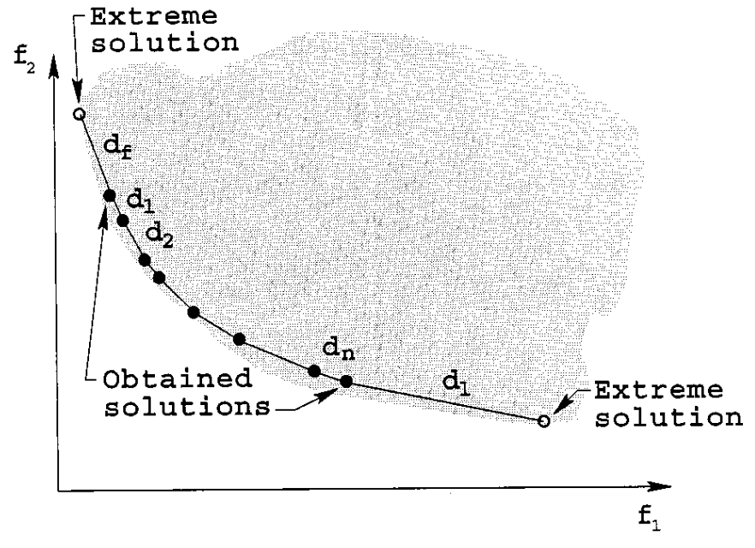
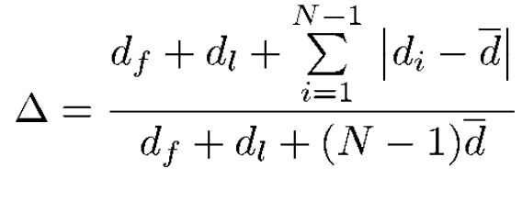
Calculating Diversity of Solutions
We use the following metric to calculate the nonuniformity in the distribution:

Slide 11
Calculating Diversity of Solutions
It is to be realized that the more diverse (uniformly spread) the set of solutions will be, the closer the value of Δ will be to zero. Hence, smaller the value of Δ, more diverse is the solution set.

Slide 12
Slightly Complex MOOP : Min-Ex Problem
Min-Ex Problem:
Minimize ƒ₁ (x₁ , x₂) = x₁
Minimize ƒ₂ (x₁ , x₂) = (1 + x₂) / x₁
subject to 0.1 ≤ x₁ ≤ 1 & 0 ≤ x₂ ≤ 5

Slide 13
Three Versions of NSGA-II
Version-I : Traditional NSGA-II algorithm.
Version-II : Modified NSGA-II algorithm, which will evaluate the crowding distances only in data space.
Version-III : Modified NSGA-II algorithm, which will evaluate the crowding distances in both, data space and objective space (crowding distances in data space and objective space for each individual are summed up).
Please note that all the simulation runs are performed on the population size of 40 and evolved upto 3000 generations.

Slide 14
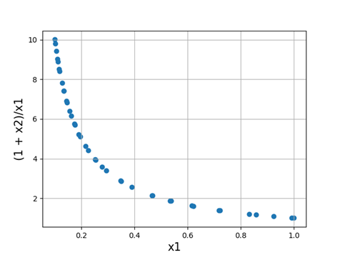
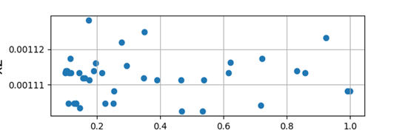
Run of Version-I
Fig.1A Data Space
Fig.1B Objective Space

Slide 15
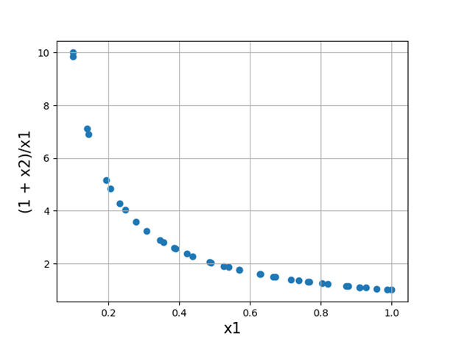
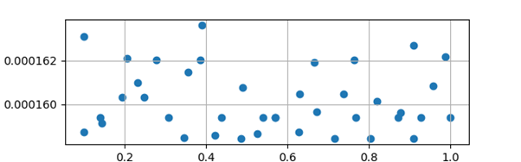
Run of Version-II
Fig.2A Data Space
Fig.2B Objective Space

Slide 16
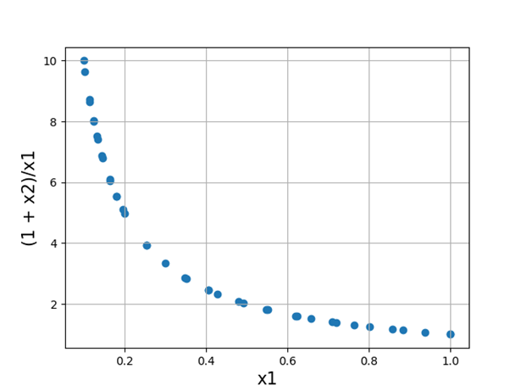
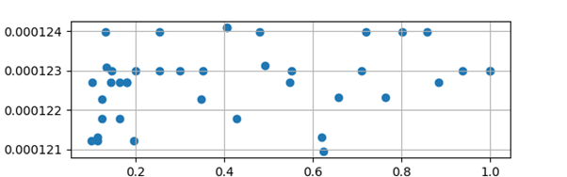
Run of Version-III
Fig.3A Data Space
Fig.3B Objective Space

Slide 17
Table 1: Mean diversity metric in data space (Δ_{d}) and Mean diversity metric in objective space (Δ_{o}) when run on Min-Ex problem
Results and Discussion
Min-Ex | Δ_{d} | Δ_{o}
Version-I | 0.9640 (Fig.1A) | 0.6971 (Fig.1B)
Version-II | 0.5556 (Fig.2A) | 1.084 (Fig.2B)
Version-III | 0.8492 (Fig.3A) | 0.8798 (Fig.3B)

Slide 18
Results and Discussion
Mathematically, we observe the following relation amongst different Δ_{d} :-
Δ_{d}(Version-II) = 0.5556 < Δ_{d}(Version-III) = 0.8492 < Δ_{d}(Version-I) = 0.9640
This is a nice result as we would have expected that the Version-II will exhibit the maximum diversity in the data space.

Slide 19
Results and Discussion
Mathematically, we observe the following relation amongst different Δ_{o} :-
Δ_{o}(Version-I) = 0.6971 < Δ_{o}(Version-III) = 0.8798 < Δ_{o}(Version-II) = 1.084
This is again a nice result as we would have expected that the Version-I will exhibit the maximum diversity in the objective space, and Version-II will give the least uniformity.

Slide 20
Conclusion
The principal improvement idea which we discussed was to achieve diversity in both, data space and objective space. We tried slight modifications to original NSGA-II and implemented it on a MOOP, namely Min-Ex problem.
Quite promising results were obtained after the experimentation.

Slide 21
Conclusion
The implementation of the Version-III proved to be quite rewarding, since it showed diversity in both the spaces.
It is to be noted that the time complexity of Version-III remains the same as original NSGA-II.
We conclude that this modification can be used in place of the traditional NSGA-II to achieve a more diverse set of solutions in both, data space and objective space.

Slide 22
Future Directions
We can take into account the idea of “archives”, from another MOEA, namely PAES [4] .
Sometimes, it is useful to keep track of good solutions that have been visited in the past, even if they are no longer active in offspring generation.
The reproducing population can perform much more active exploration, instead of being filled up with old solutions. This idea can be further incorporated in the modification of Version-III, and is yet to be explored.

Slide 23
References
[1] K. Deb, Multiobjective Optimization Using Evolutionary Algorithms. Chichester, U.K.: Wiley, 2001.
[2] K. Deb, A. Pratap, S. Agarwal and T. Meyarivan, “A fast and elitist multi-objective genetic algorithm: NSGA-II”, Proc. Parallel Problem Solving from Nature VI, 2000
[3] J. D. Schaffer, “Multiple objective optimization with vector evaluated genetic algorithms,” in Proceedings of the First International Conference on Genetic Algorithms, J. J. Grefensttete, Ed. Hillsdale, NJ: Lawrence Erlbaum, 1987, pp. 93–100.
[4] J. Knowles and D. Corne, “The Pareto archived evolution strategy: A new baseline algorithm for multiobjective optimization,” in Proceedings of the 1999 Congress on Evolutionary Computation. Piscataway, NJ: IEEE Press, 1999, pp. 98–105.

Slide 24
Thank you

